Slide 1

INVESTIGATING THE DYNAMICS OF THEME PARK RIDES

Slide 2
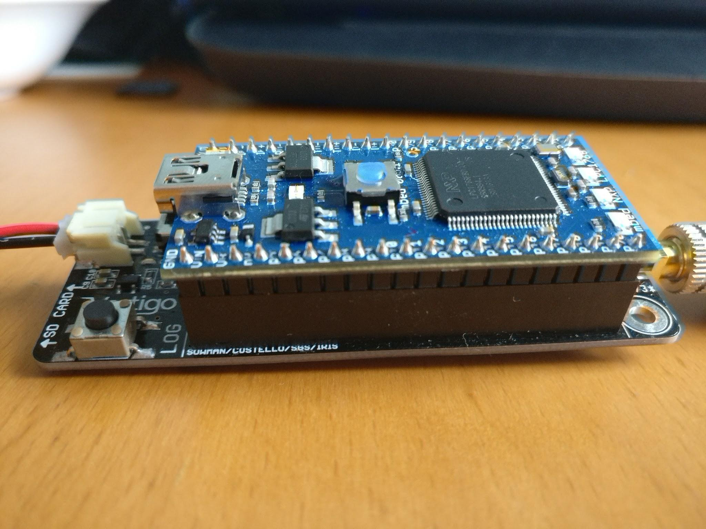
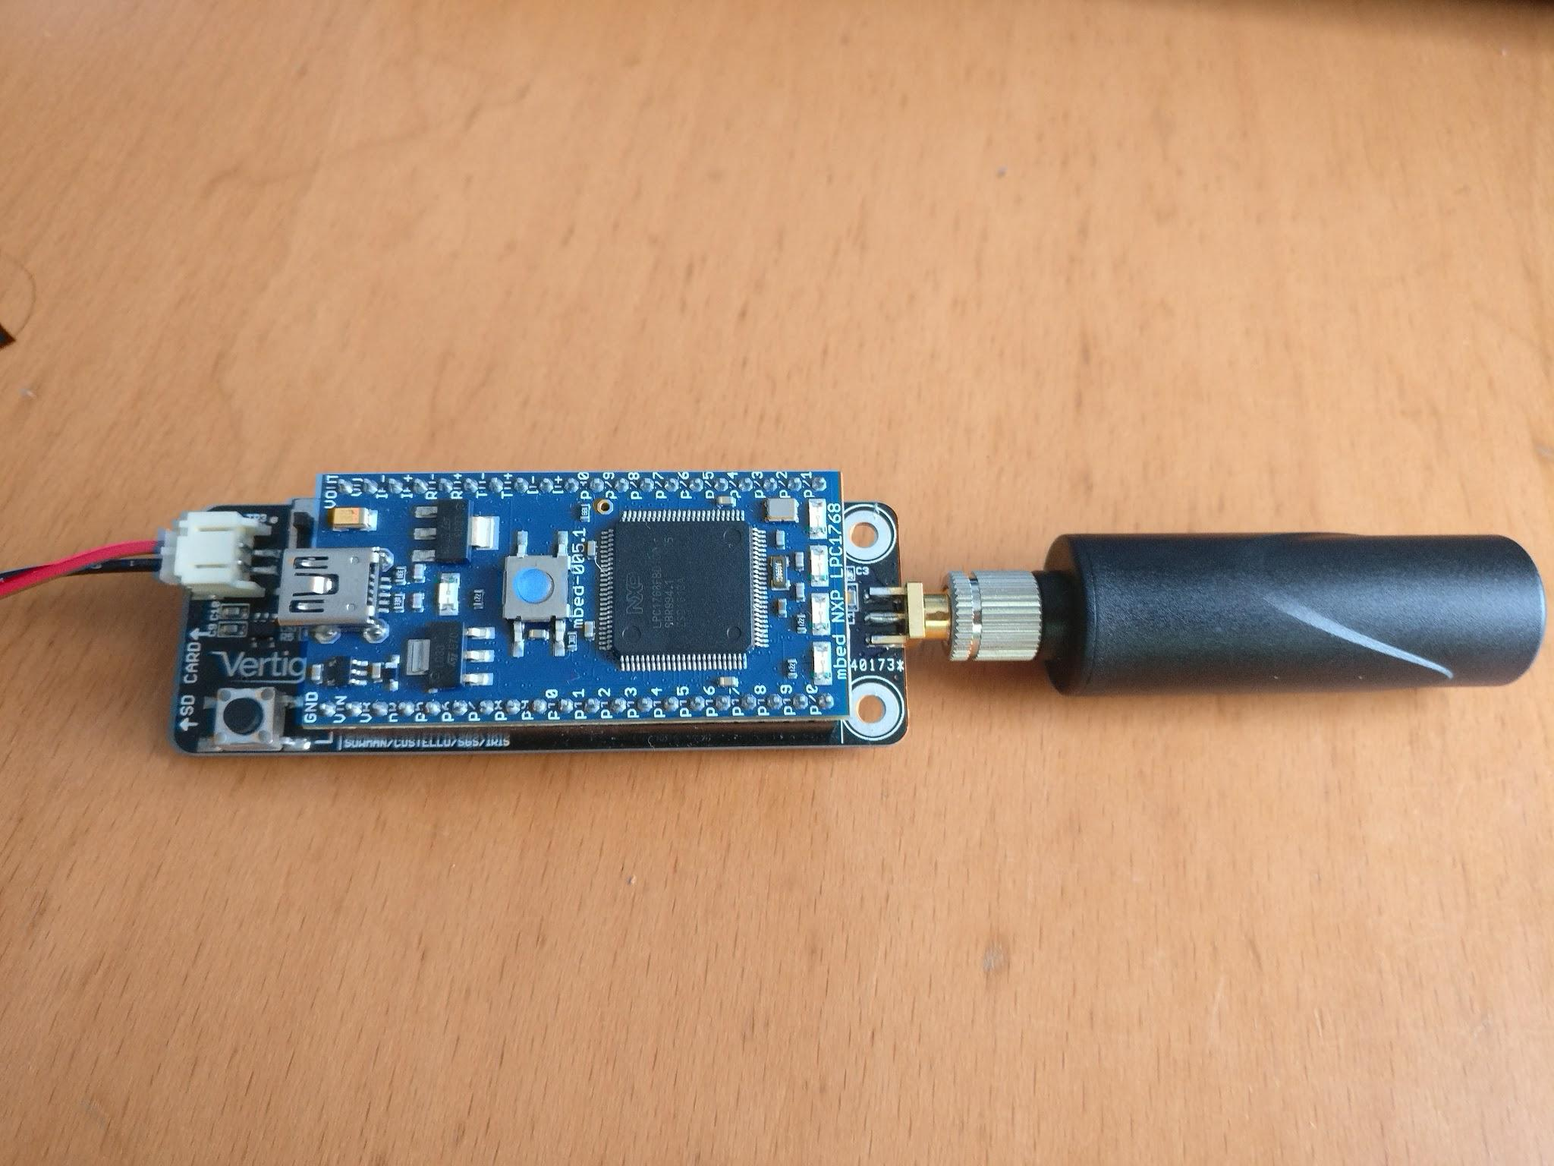
What is ‘Vertigo’
Inertial Data Logger
Detects gravity and Earth’s magnetic field
Calculates its own orientation
Notes:
Vertigo is an inertial data logger which measures its acceleration, position and rate of rotation. What is interesting, however, is that Vertigo detects gravity and the Earth’s magnetic field, calculating north and the downwards direction, which allows it to work out its orientation in a world frame which is stored as a quaternion.

Slide 3
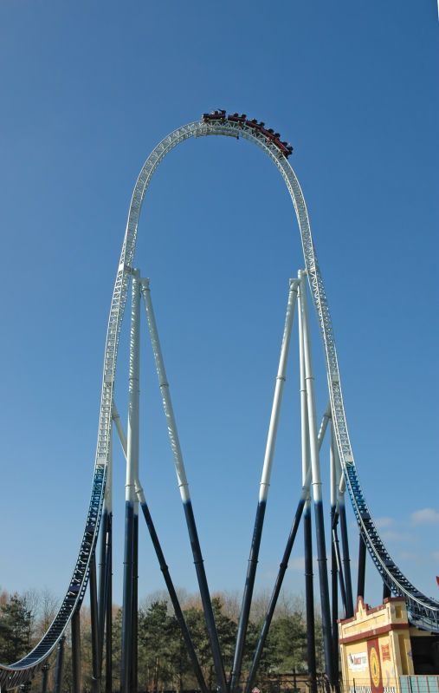
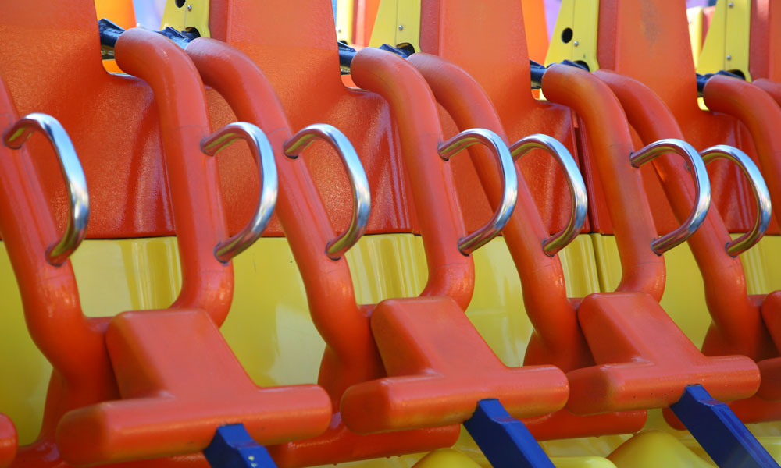
Our Aim
‘To quantify our experience’
Rush of blood → G-Force
Dizziness → Angular Velocity
Notes:
What we set out to do with Vertigo was to be able to quantify our experience on theme park rides. So, for example, a rush of blood or being pushed into your seat could be measured by G-Force and a feeling of dizziness could be quantified by angular velocity. We wanted to be able to compare rides, show the best parts of rides as well as evaluate the safety of the rides.

Slide 4
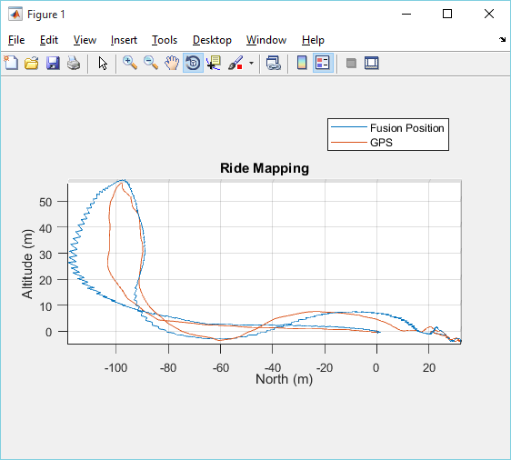
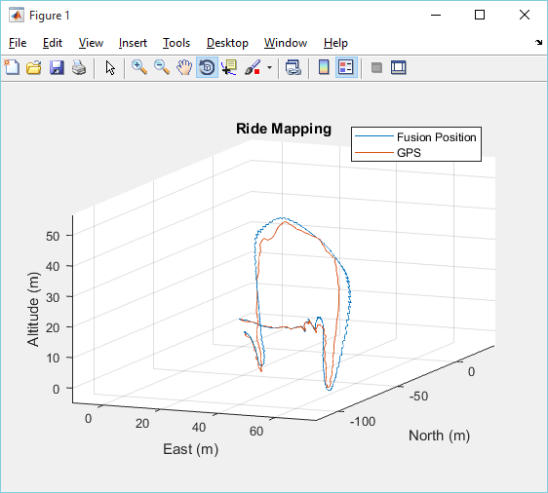
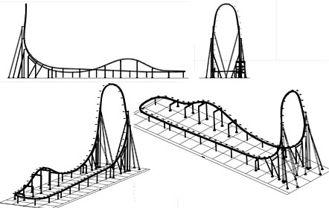
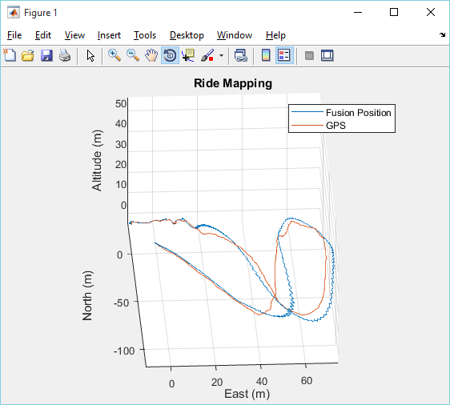
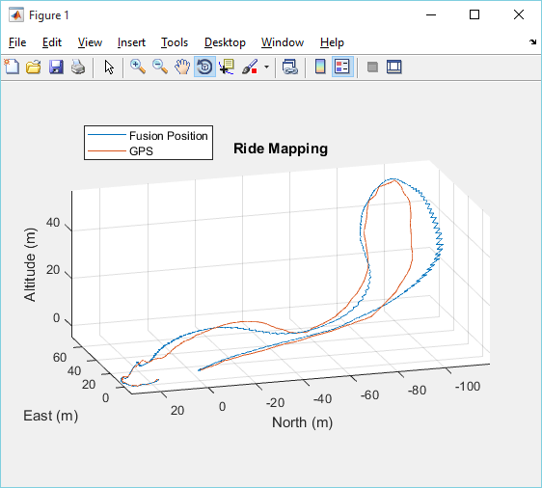
Stealth Analysis - Ride Map
Notes:
Vertigo measures its position by GPS but it also measures its acceleration, which can be integrated twice to work out the distance moved. Doing this, we now had two sets of values for position, allowing us to blend the two data sets using a Kalman filter for a more accurate path estimation. The ride shown here is Stealth, and you can see how the blended data – the blue line gives a better path estimation.

Slide 5
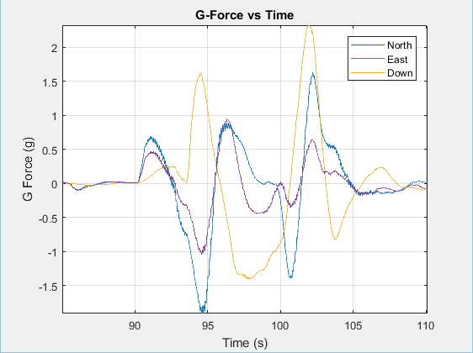
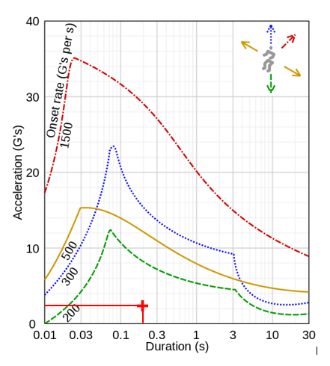
Stealth Analysis - Safety
Robert V. Brulle (2008). Engineering the Space Age: A Rocket Scientist Remembers
Notes:
To measure safety, we decided to compare the experienced G-Force with an existing study on the human body’s tolerance to linear acceleration. We did this by looking at the acceleration in three orthogonal axes, North, East and Down. Looking at the graph, initially there is a small acceleration in the North and East directions followed by a spike in Down acceleration and a deceleration in the east and North directions. This is as expected as the track starts of flat, then enters a steep climb with little movement in the North and East Directions. The same cycle happens again as the track stays flat at the top for a bit before its descent and back to being flat. When compared to the study, the maximum G-Force in any direction is 2.3G for 0.2 seconds which is represented by the red line in the second graph as the carriage points downwards with the track. As shown, the experienced G-Force is well within the human body’s limits, marked by the red cross and we can conclude it is safe.

Slide 6
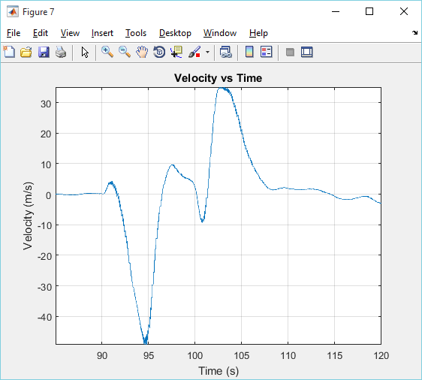
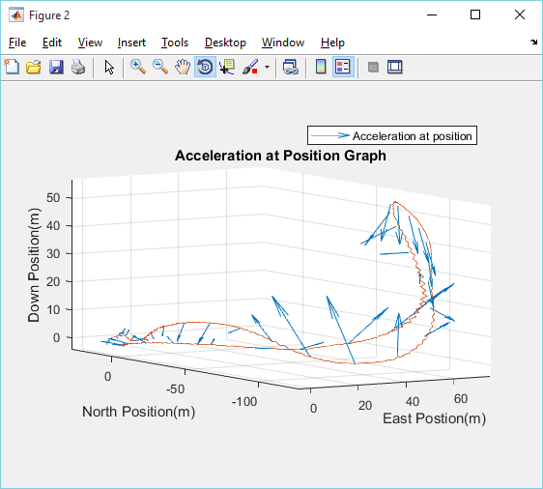
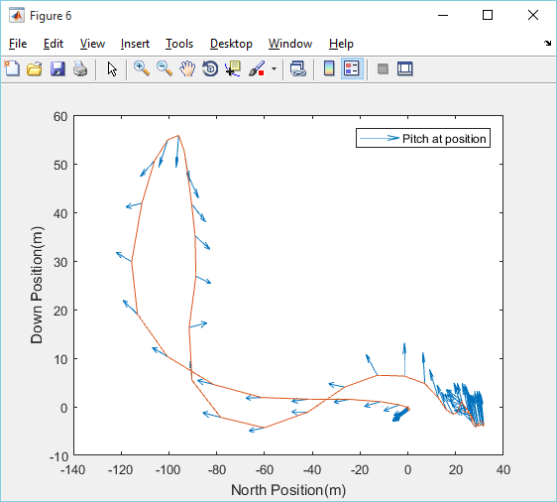
Stealth Analysis - Best Parts
Notes:
To judge our best part of the ride, we decided to look at 2 factors, the acceleration and the rate of rotation. In order to best see acceleration, we decided to use arrows to show acceleration at different sections, where the arrows direction is based on the three acceleration vectors. As shown, the largest acceleration occurs at the bottom of the downhill section of the ride, which is what we would expect. The rate of change of rotation is shown by change in direction of the arrows which show that at the top is where you rotate the fastest in the ride.

Slide 7
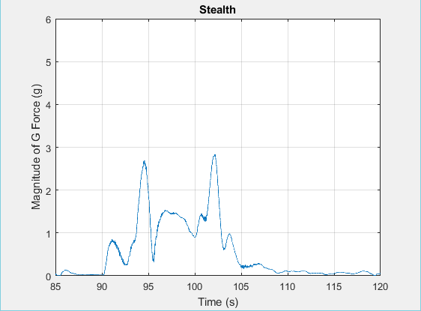
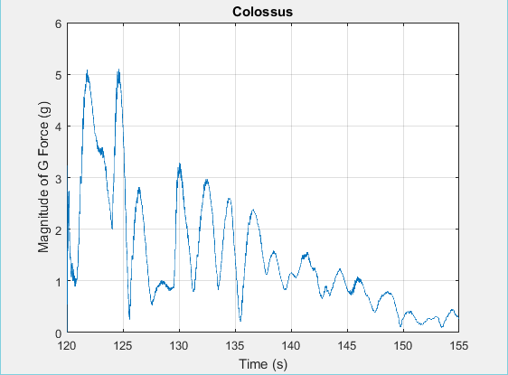
Stealth vs Colossus - G-Force
Notes:
On this slide, we compare the magnitude G-Force experienced on Stealth to another ride, Colossus. We calculated the magnitude by using Pythagoras on the three orthogonal vectors. One interesting thing to notice is that at the start of Stealth, you accelerate from 0 to 83mph in 1.1 seconds, and yet the G-Force experienced is small compared the G-Force produced by rotating. Colossus has lots of loops which explains why it has a high G-Force and why the graph looks sinusoidal. The decrease in G-Force at the peaks is representative of the fact that energy is lost throughout the ride.

Slide 8
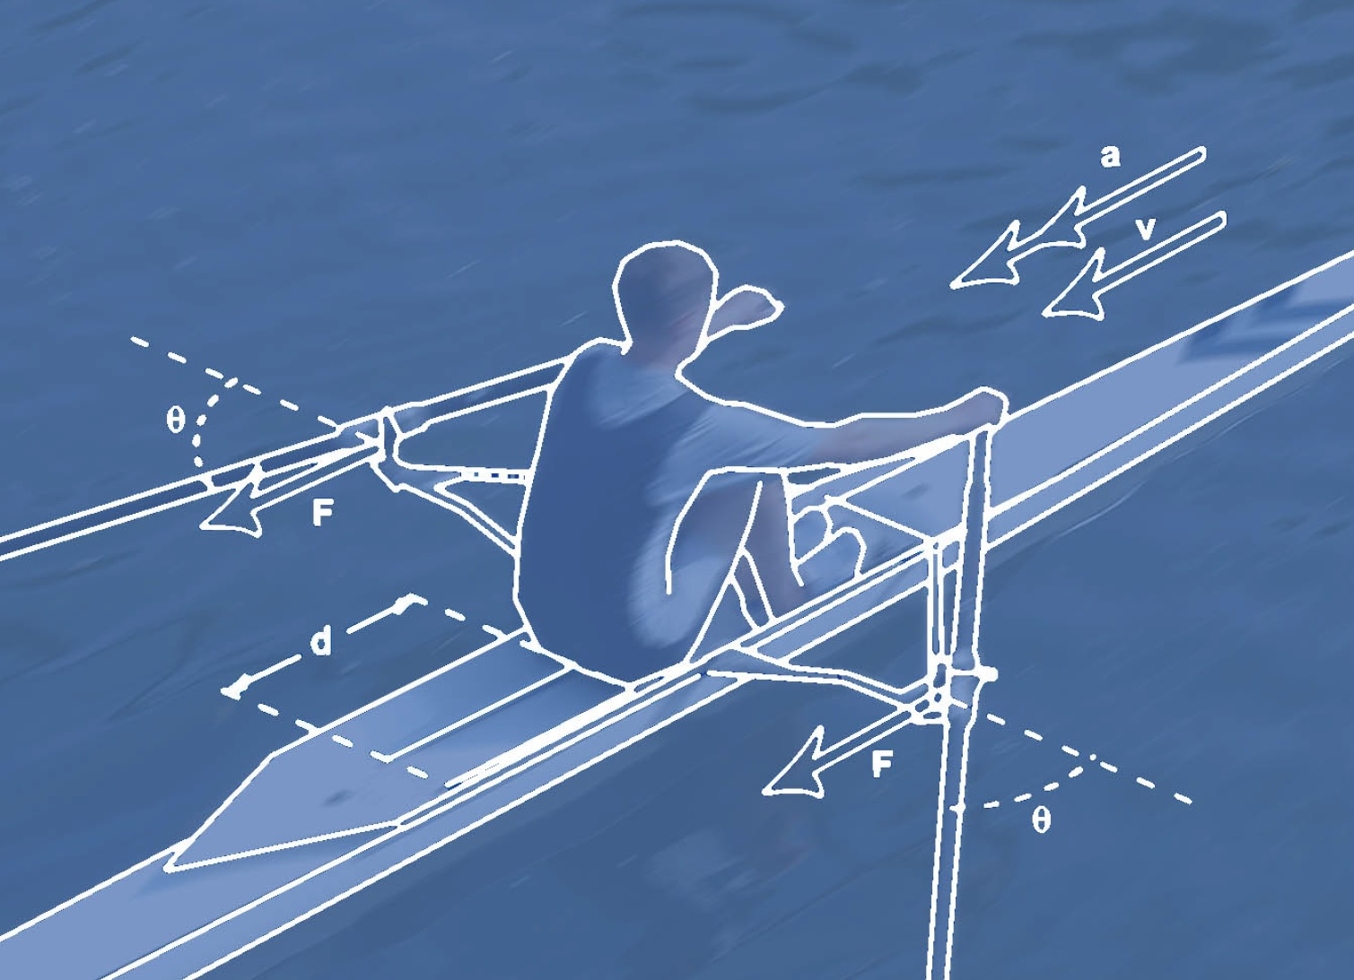
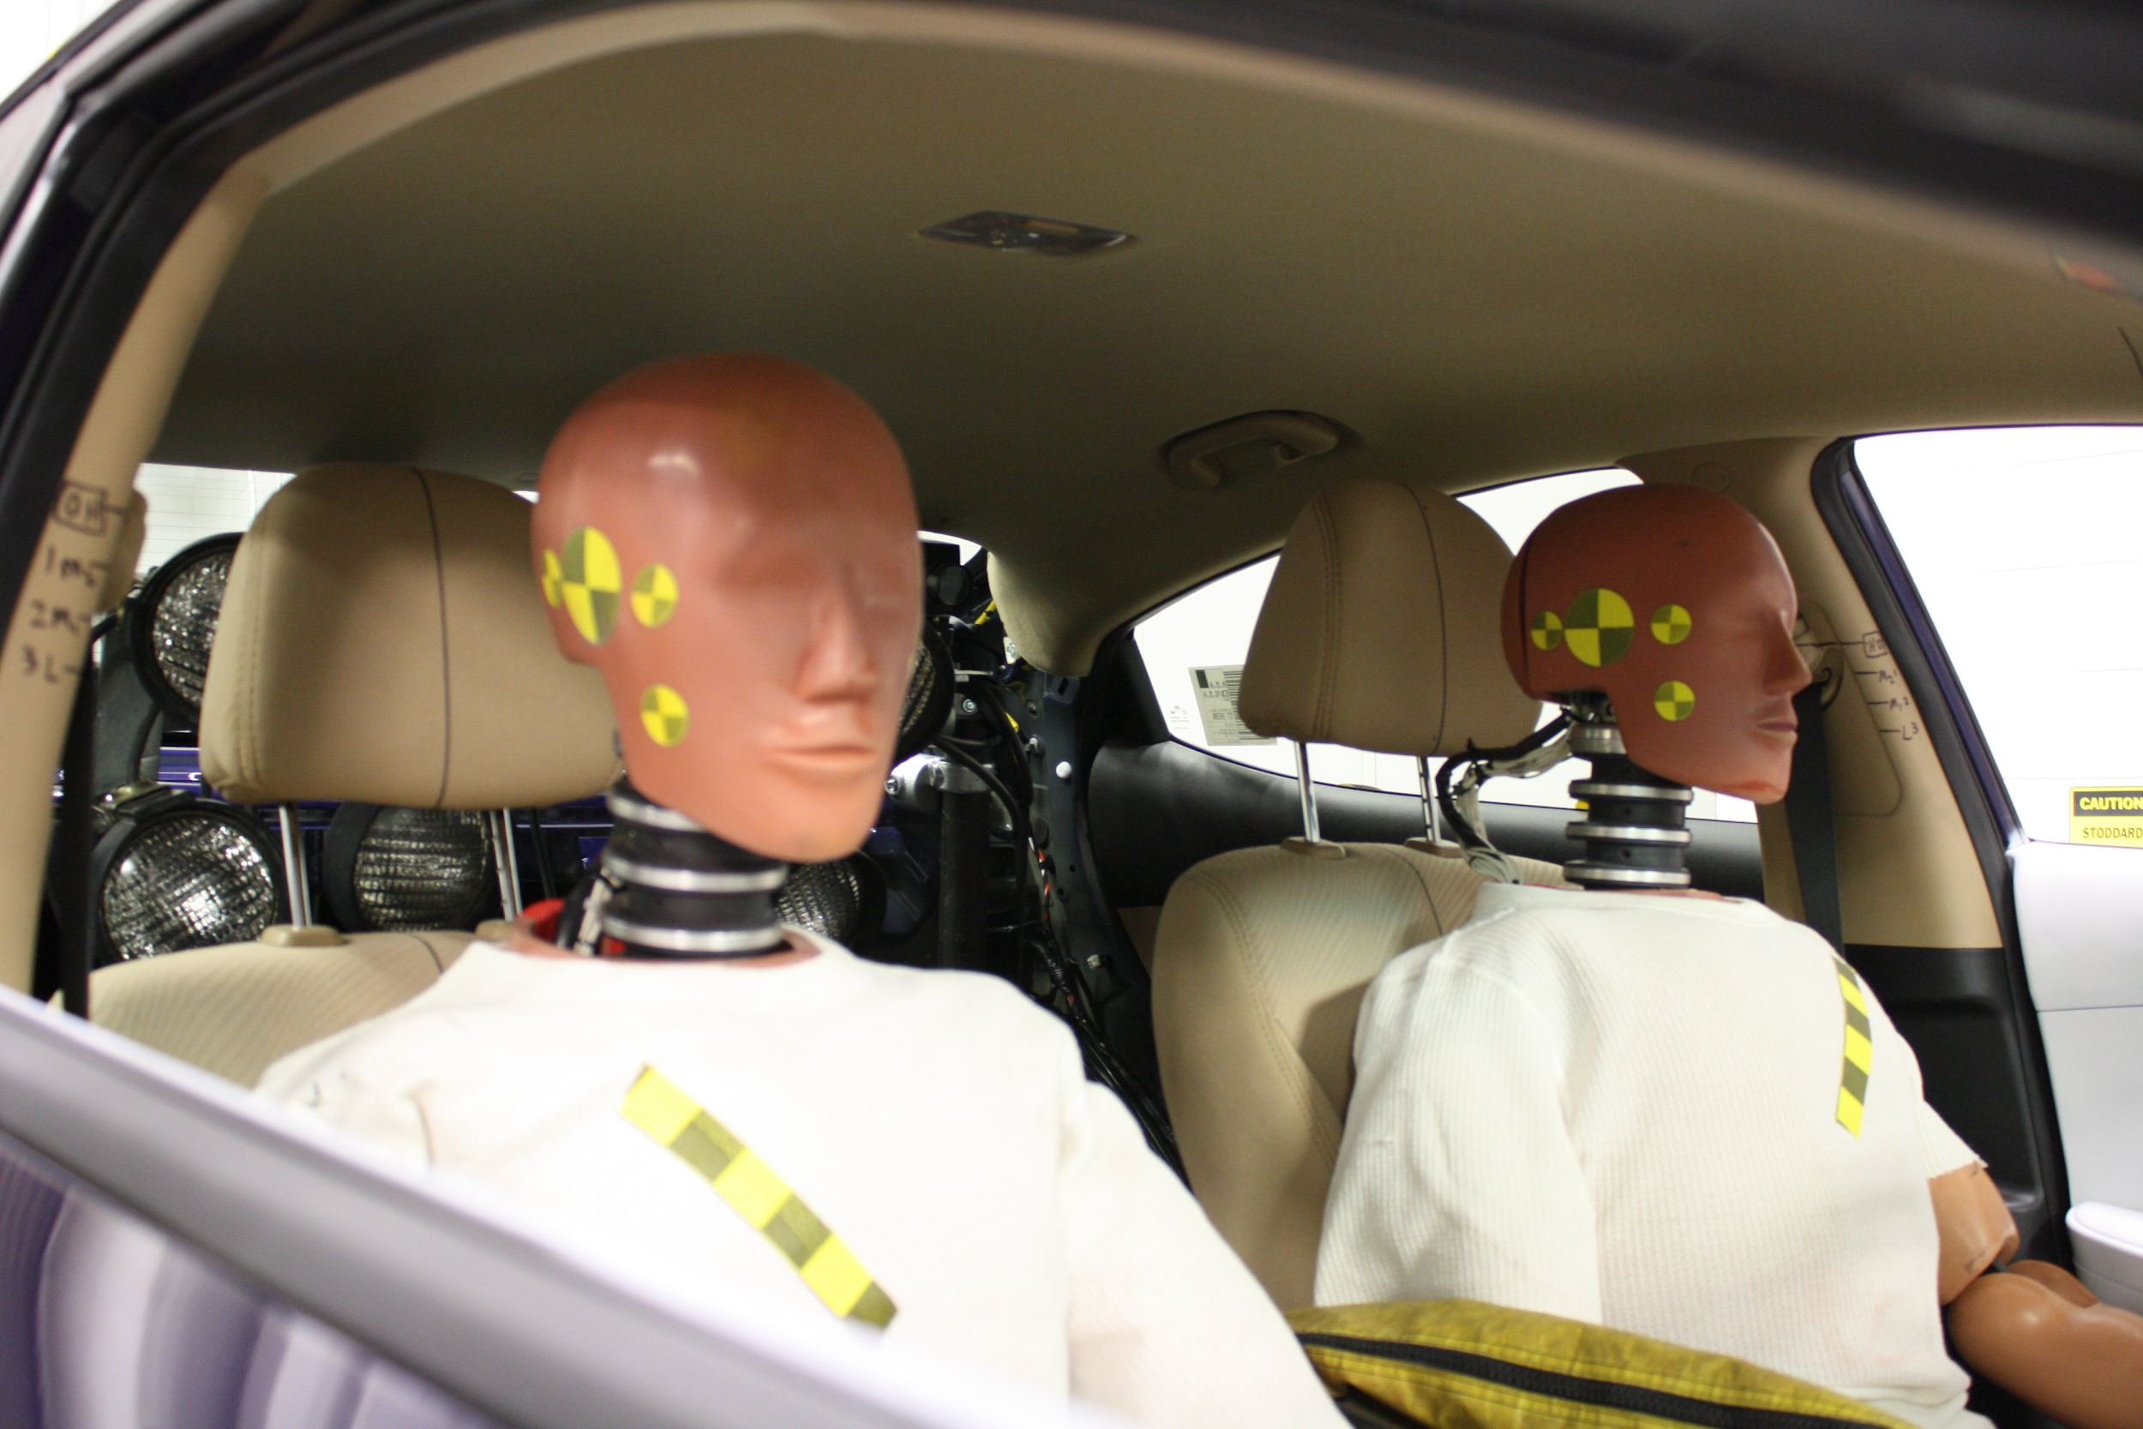
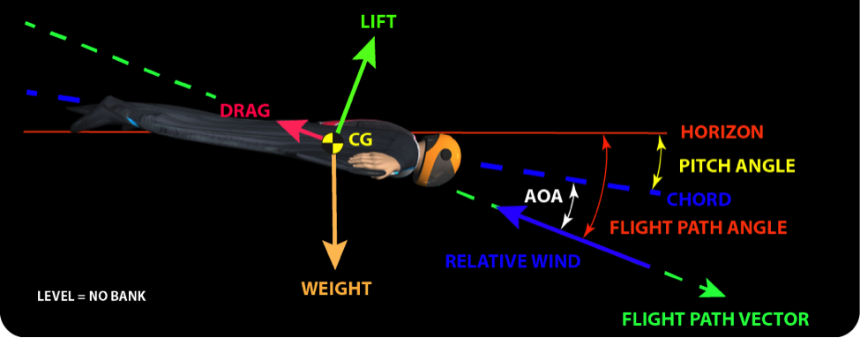
Further Applications
Finding optimal AoA for wingsuits
Sports analysis e.g rowing
Crash Test Dummies
Notes:
We can apply our method to any other situation where having access to accurate data is useful. For instance, calculating the optimal angle of attack on a wingsuit glider, where over or under-rotating could lead to death. Also, vertigo has application in rowing where you can see how synchronised the members of a team row, or the angle and rotation of oars. Vertigo can also be used in engineering as Vertigo can detect how smooth or ‘jerky’ its movement is, which would be useful for example on a crash test dummy in airbag testing.

